Slide 1


Volunteers’ Management System
Mid-Term Seminar
V M S
Apollo Group:
Abdullah Arslan
Abdollah Tabareh
Gilana Ramezani
  Mustafa Al-Zubaidi
Shobha BC
Tigran Harutyunyan
  Waseem Soomro

Slide 2
Agenda
Problem
Solution – VMS
Scope
Stakeholder
Features
Use Cases
Screen Mock-ups
Future Plan & Needs

Slide 3
Problem & Background
Help Organizations : Civil Defense, Red Cross
Difficult membership procedure
People are willing to help others when there is a crisis
People don’t want to join if there is not any crisis
There is a huge unused human power in most of the crisis
Help organizations are not currently utilizing citizens

Slide 4
Solution: VMS
VMS aims to use the citizens for help and rescue operations
Citizens can easily become volunteers by a simple registration
VMS helps:
    In communicating between the help organization managers and volunteers
    Organizing the volunteers for different incidents in crises

Slide 5
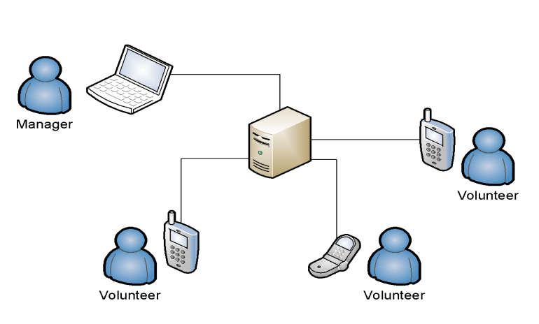
Scope
VMS mainly will be used
during and after crisis time
VMS assumes that :
  There is internet connection for mobile phones
  Volunteers have mobile phones with:
    Java support
    Internet connection

Slide 6
Stakeholders and Users
Stakeholders:
Help and rescue organizations
  Civil Defense
  Red Cross
Course coordinator
Users:
Citizens
Crisis mangers of help organizations

Slide 7

Features
Registration & Membership
Profile Management
Incident Reporting
Warning the Volunteers
Resource Management
Incident Management
Commanding Volunteers

Slide 8
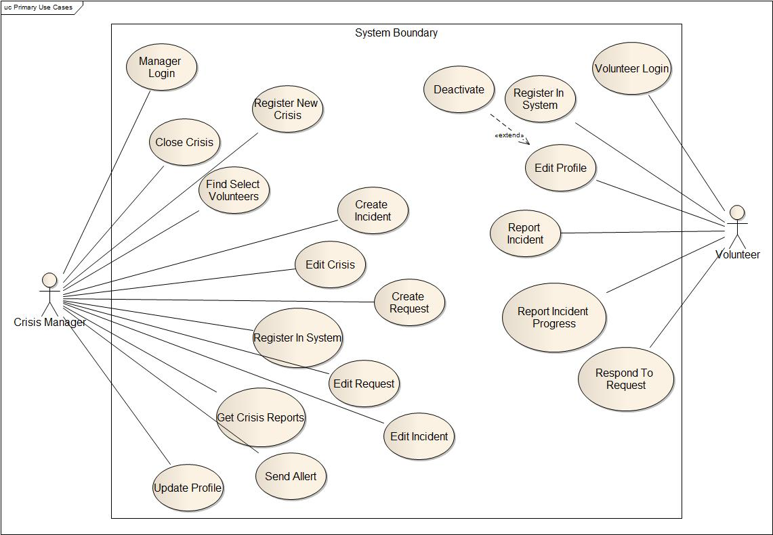
Overall Use Case Diagram

Slide 9
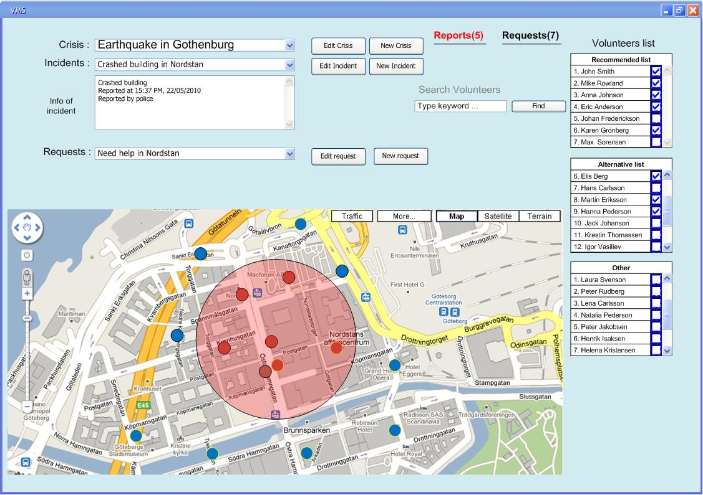
Screen Mock-ups : Manager

Slide 10
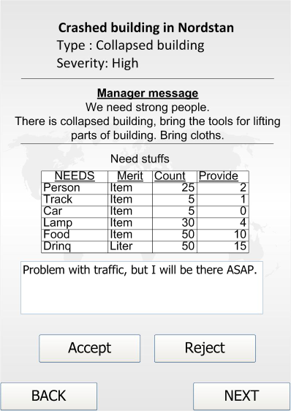
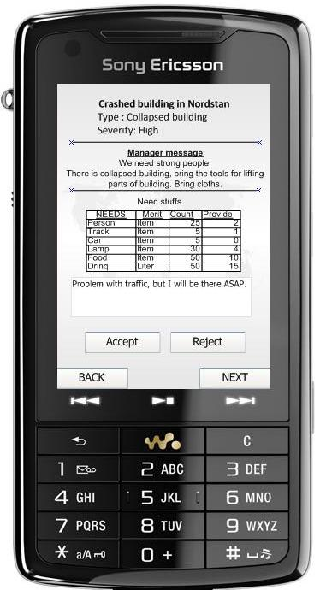
Screen Mock-ups: Volunteer

Slide 11
Future Plan & Needs
Software Requirement Specification
  Detailed Use Cases
  Activity Diagrams
  Supplementary Specifications
  Screen Mock-ups
Architectural Overview Document
Need : Stakeholder Involvement

Slide 12

Questions

